Slide 1
MedCommons PFP SubSystem v2
Annotations, Comments and Outright Requirements
Hacks of previous slides are in Pusia

Slide 2
Things to Add
Discuss Forms Design Process
Discuss Required and Optional Form Fields
Discuss ‘Next Procedure’
Discuss Mapping of Users to Roles
Discuss Tasklist Filtering
Cleanup Naming Ambiguity

Slide 3
Deliverables
User Tasklist with Filters by Role, Time…
Form Filler (PFP) - Creates, Updates and Stores Records from Forms (Templates) and generates TODOs
Form Builder that Makes New Forms from scratch or from existing Forms
Signature Pop-UP for Signing Records and Forms as means of completing TODOs
Persistence via MySql, FileSystem, SVN

Slide 4
Worklist/Tasklists
Tasks are Just Records with Status that must be disposed of by Users in Roles
You can only get a task off the list by signing it – at which point the task is given to another User in a Role as determined by the ‘Next Procedure’ field in the record

Slide 5
Tasklist for J Bloggs, Chief System Guru, 5/20/04
Stat | Record | Pri | Entered | DropDead | Comments
¥ | Approve Design of new CoLo |  | 5/17/04 | 5/22/04 | Free form with links
 | MySQL Perf Review |  | 5/14/04 | 5/23/04 | Extracted from the Record
 | Attend Mgmt Review |  | 5/18/04 | 5/20/05
 | Install new SVN release |  | 5/20/04

Slide 6
Process (Role) Worklists
?User Tasklists?
Tasklist is a better name as it is consistent with Eclipse and not confued with Modality Worklists
Filters can be established via UI to determine what’s in a particular tasklist
  The filtering mechanism will get fancier in subsequent revisions, but must include a basic filter by role and priority
View in Web Browser or Eclipse
  If web form then would be invoked by type as separate editor from eclipse.
Automatically Updated by Process Forms Processor
  When the PFP pushes new data into task table, the worklist viewer must update itself. For a first cut, an autorefresh page would be ok
Administrative intervention managed through Exception Forms
  There are 2 ways to get something to change status in the Tasktable
    Do the task and SIGN IT (different types of signatures for different states)
    Some special forms have embedded abiity to change task status, and they temselves will need to be SIGNED to be executed

Slide 7
Records
Records are just filled in or partially filled in Forms that have been signed
Even a partially filled in form is signed as the mechanism to push the record onto the next step

Slide 8
Product Code Submission Record
Form #: QA EML 3 852 12 01
Record # : ZZ 3 432 42 X
Description: Check In 3D Slicer Math Routines Ver 3.2B
Component | Requirement Spec. | Design Spec. | Test Spec. | Test Result | Traceability Matrix Reference
Arctan.java | InverseTrigSpec | …
Slicer3d.java
Next Procedure: Test3d
Name Title Role Date__________
SEAN DOYLE CMO SWEngineer January 12, 2004
Signed: JK83H320SX34NDIMWIK27

Slide 9
Record Signing
Allows flexible signing plug-ins, including no signing at all
For the first cut, uses USPS system via JAVA SDK
  The base documents will be signed separately via USPS plugins
  Ultimately we may not want to pay for minor records to be signed via USPS scheme, so multiple schemes should be allowed for different form types
All signings separately logged
Can not complete “task” until the user ‘signs’ that it is done

Slide 10
Forms
Forms are Just Templates
There is a Form Designer that Makes and Edits Forms
Forms may be partially filled and stored as other Forms
Forms must be signed by their creator

Slide 11
MedCommons Process Form Format
Document #: QA EML 3 852 12 01
Doc. Title: Product Code Submission Form
Description: This is a typical controlled code submission
Component | Requirement Spec. | Design Spec. | Test Spec. | Test Result | Traceability Matrix Reference | Next Procedure
Component 1.txt | Document Link | … |  |  |  | Product Test
Component 2.src
Name Title Role Date__________
Adrian Gropper CMO Prod. Mgr. January 12, 2004
Signed: JK83H320SX34NDIMWIK27

Slide 12
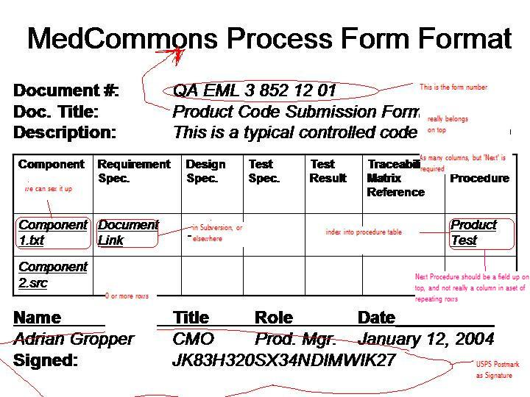

Slide 13
Process Forms Processor
User Navigates and Selects Form to fill from Tree
  Form is Presented to User as a ‘ Record’ for fill-in
Enforces Syntax of mandatory fields and referential integrity of links
  Presupposes that all referenced files must actually exist.
Automatically Pack and Save context to 21 CFR-11 Archive
  Shouldn’t it say content?
  Need to discuss representation of the records on disk and whether data and/or metadata in real database
  The Archive is NOT Subversion
Add / Remove items from Process (Role) Worklists
  There is data that can be entered into a form or a record, which when interpreted by the PFP causes the record to be placed on one or more worklists/tasklists when it is ‘completed/signed’ by the form filler
  The ‘Next Procedure’ Field serves as in index into a business rule which specifies which ‘Roles’ need to deal with this record, possibly multiple
  At any point in time each Role has one or more real people assigned who can fulfill this role

